Slide 1








Gas Detekt
Welcome Nguyen Hung
New Area
No Gas Leak
Normal
Sensor index: 0
Kitchen
Warning! Gas Leak Detection
Danger
Sensor index: 124
Rom 304
Warning! Gas Leak Detection
Very Danger
Sensor index: 227

Slide 2
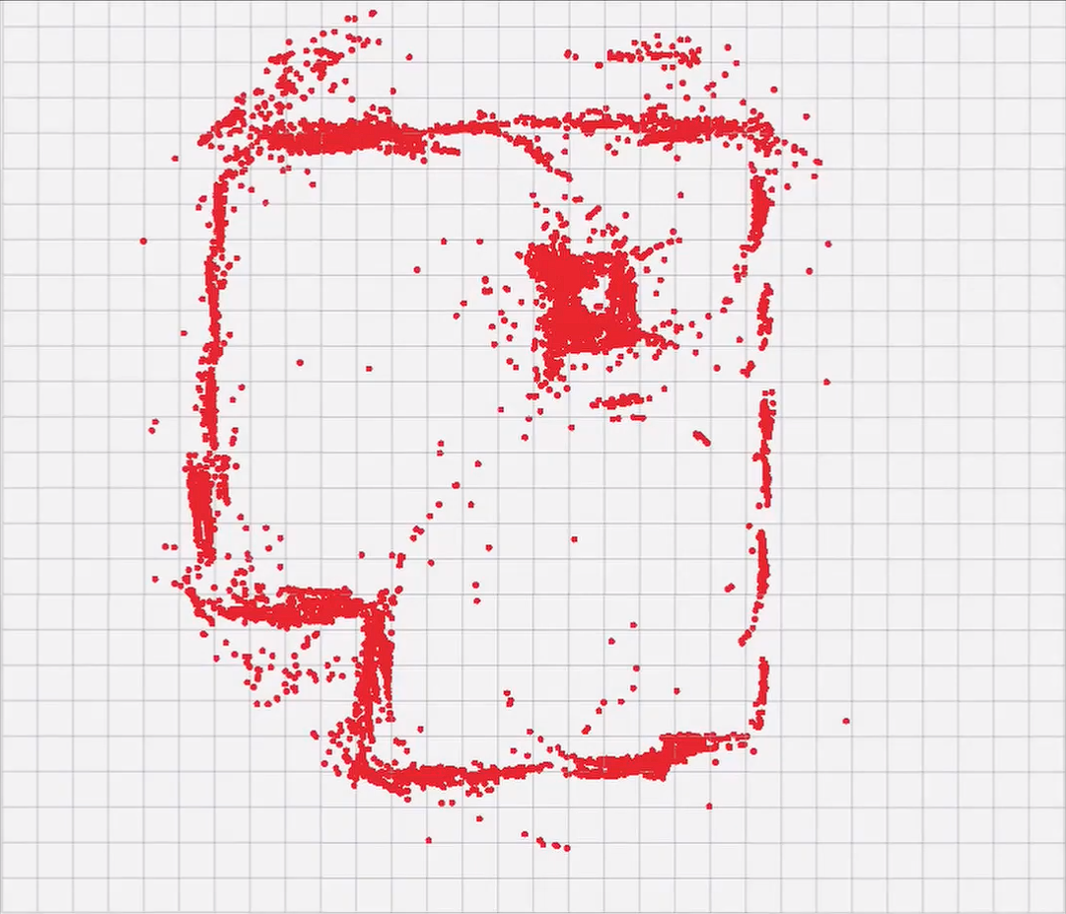





Room 1203
Name: Room 1203
Status: Normal Gas sensor: 0
Device: Gas Detect Robot
S/N: RB23GD0001
Connection
Connect

Slide 3

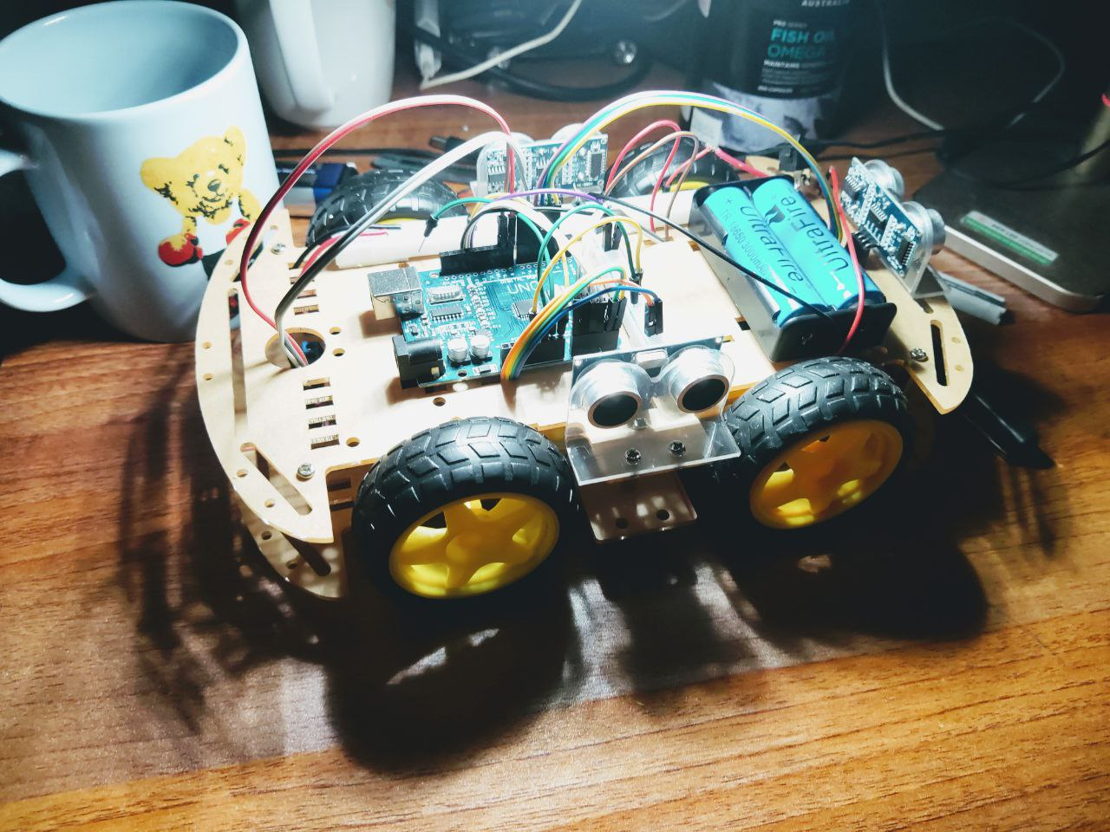
Gas detection robot
Model Name:
Gas detetction robot
Serial Number:
RB23GD0001
Status:
inactive
Specification:
Board: Raspberry pi 3
CPU: 64-bit quad-core ARM
Connection: Wireless LAN
Memory: 1GB
.....

Slide 4

Gas Detekt
Connect to Robot
Username
Password
SIGN IN
Don’t have an account? Create here

